Slide 1
TEACHER CUE
CFU
HINT
Scaffolding for students
MAKE THE CONNECTION
Allow students to make the connection

Slide 2
We are learning about alloys
TRACK WITH ME
READ WITH ME
identify different alloys and explain, using examples, why we use them.
explain why alloys are mixtures

Slide 3
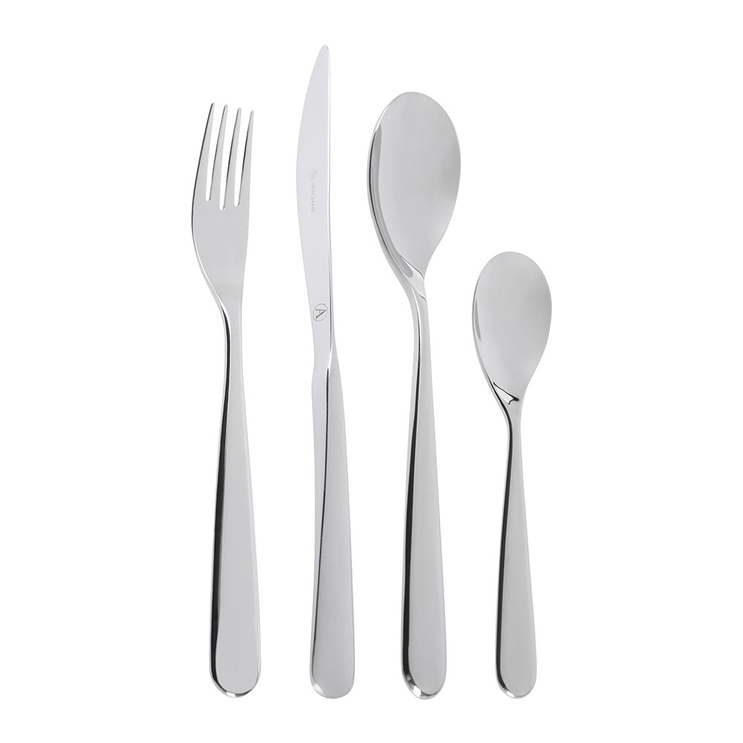
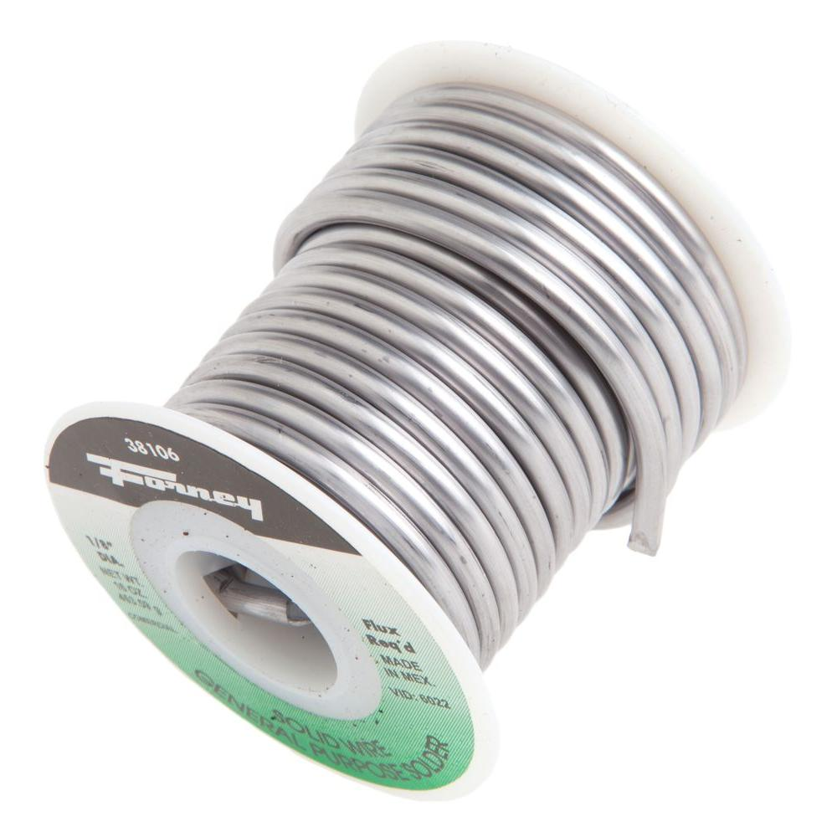
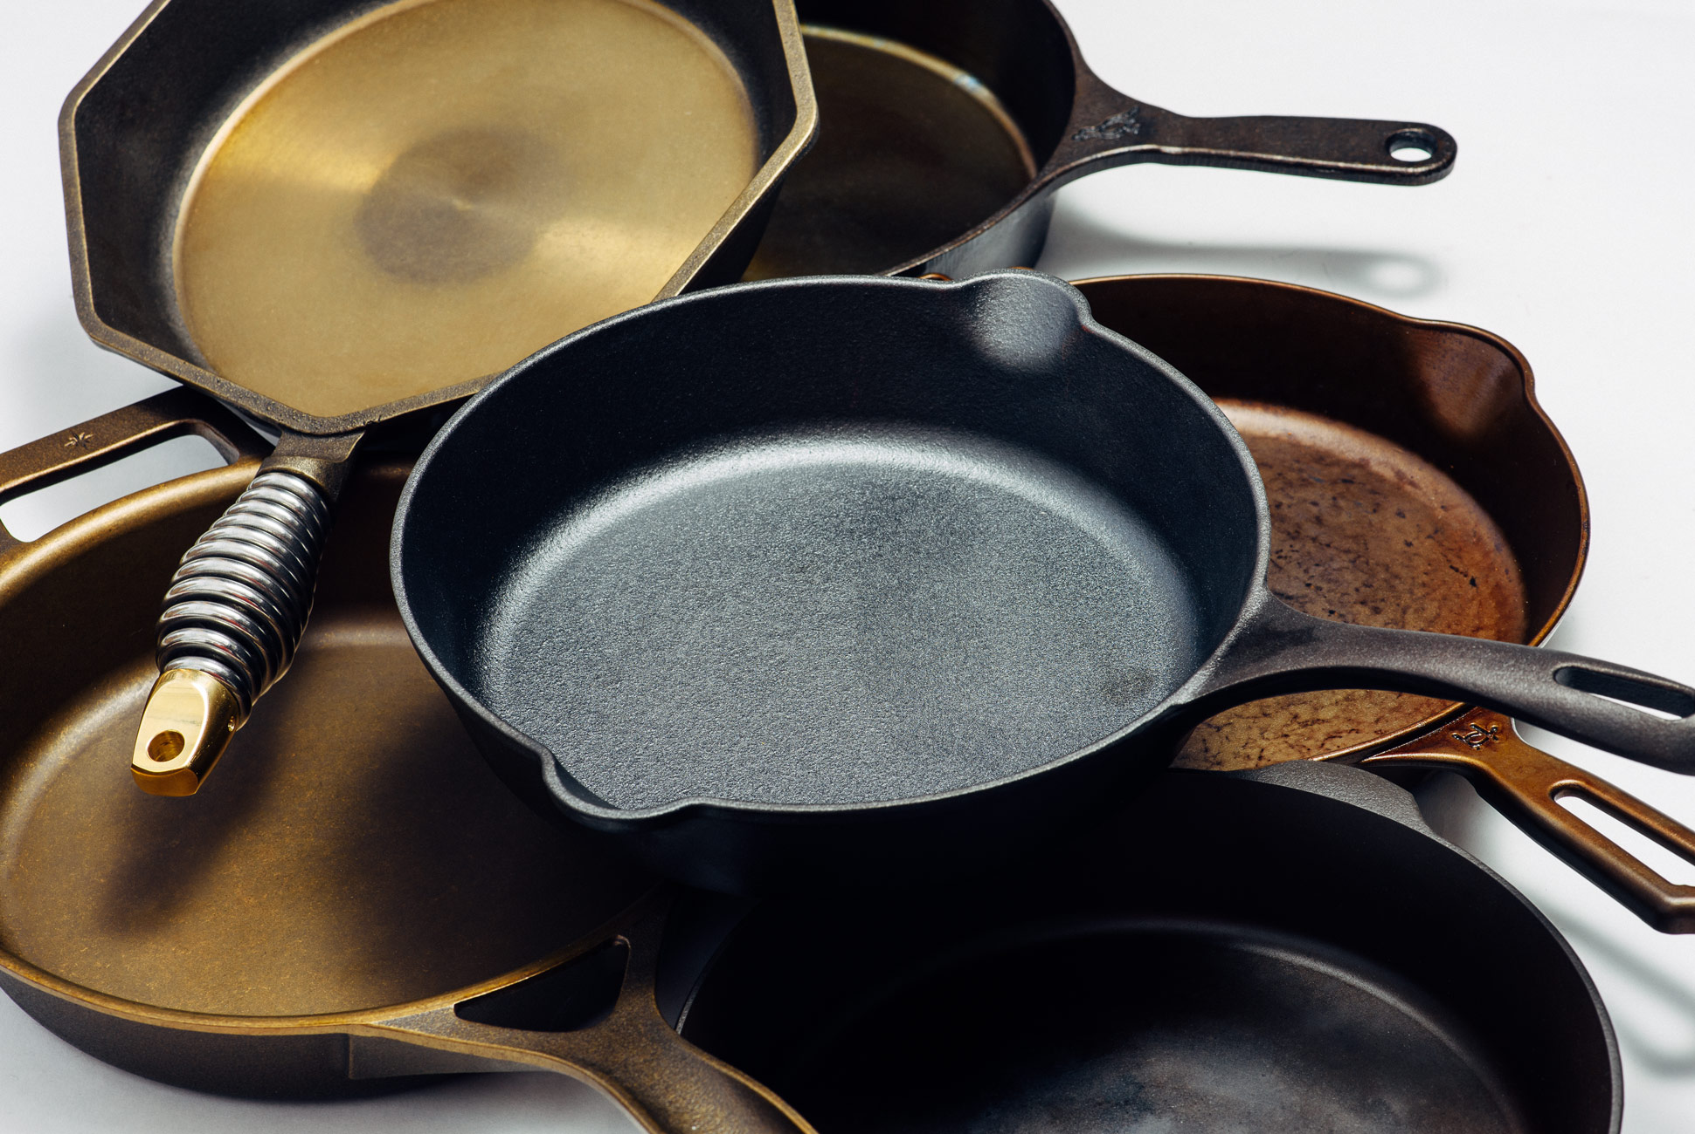
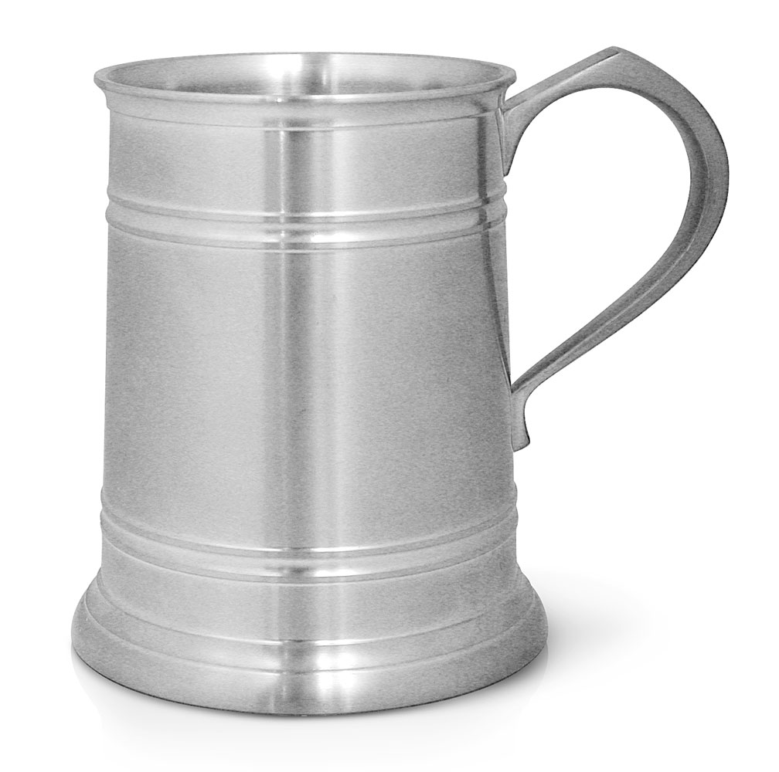
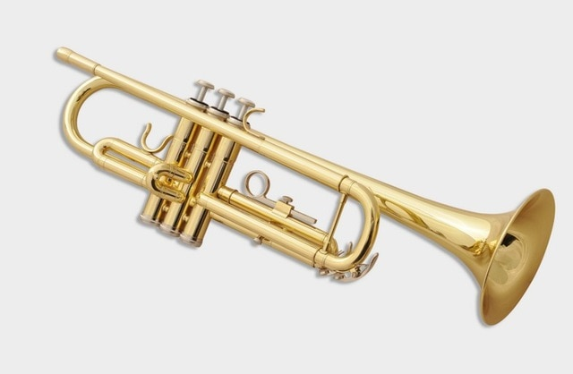

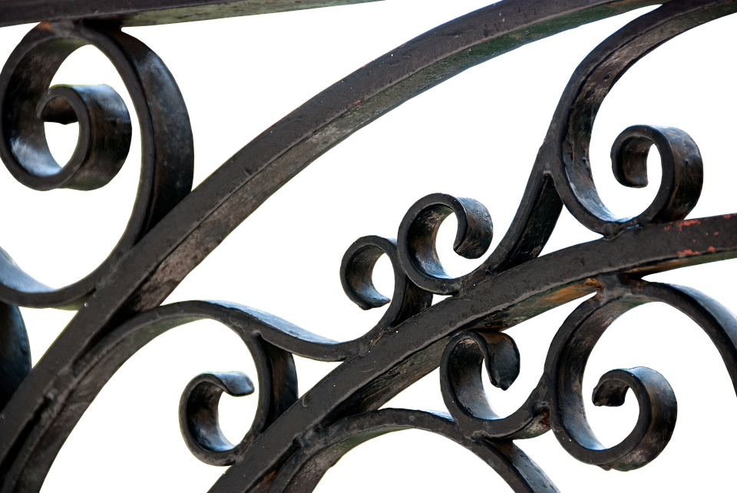

Alloys in your home
It would be almost impossible to find a single room in your house that didn’t contain a metal alloy.

Slide 4
identify different alloys and explain, using examples, why we use them.
MAKE THE CONNECTION
Alloys – Used in every aspect of modern life In the home In business In industry In your phone
History of Alloys
Metals did not become very useful until humans discovered how to make the first metal ALLOYS around 3500 years ago.
In antiquity, bronze was the first alloy, or combination of metals, that impacted humanity.
The Sumerians in the third millennia BC, developed an alloy of 90 per cent copper to 10 per cent tin.
Harder and more chemically resistant than pure copper, societies which utilized bronze tools and weapons easily ruled their neighbours.

Slide 5
identify different alloys and explain, using examples, why we use them.
MAKE THE CONNECTION
Alloys – Used in every aspect of modern life In the home In business In industry In your phone
We have the Persians to thank for the development for carbon steel in the 16th century BC and starting the Iron Age (in which we are arguably still living).
Steel is the still the most widely produced metal, and is the building block of modern society.
Early carbon steel was produced when iron was hammered and wrought in the presence of carbon (that was released by the fires used to heat it.)

Slide 6
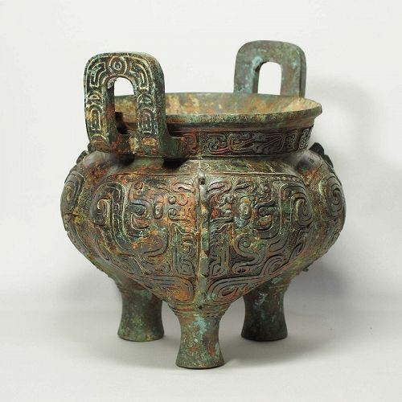
identify different alloys and explain, using examples, why we use them.
The Bronze Age (c. 3200–600 BCE)
Bronze was useful because of a few properties.
It was extremely strong
It was very malleable
It melted at a temperature that could be achieved by the fires available at the time.
It was highly resistant to corrosion

Slide 7
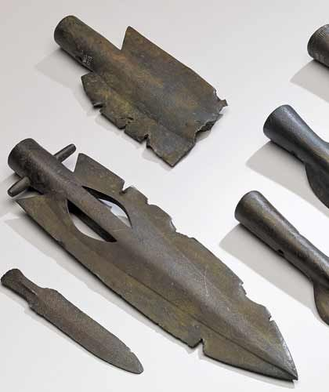
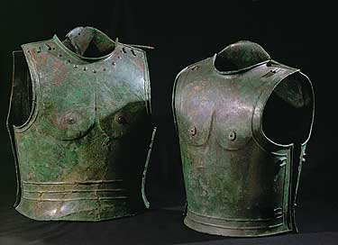
identify different alloys and explain, using examples, why we use them.
The Bronze Age
Using bronze the ancients could make;
Strong weapons (the only other weapons available were made of wood and stone).
Strong and durable utensils and cooking vessels
Statues and figurines that would last a long time.
This helped them to establish a culture and spread it easily.

Slide 8
identify different alloys and explain, using examples, why we use them.
What is an alloy?
An alloy is a mixture of different metals, or of a metal and a non-metal.
Alloys often have properties that are different from the pure metals in ways that make them more useful

Slide 9
Comparing properties of alloys and pure metals
Many pure metals are too soft for many uses.
They can be made harder by adding another element to the pure metal, so forming an alloy.
This explains why an alloy often has more uses than the pure elements it is made from.
Pure iron, for example, is very soft.
Adding a small amount of tungsten to iron makes tool steel, which is harder than pure iron.
Steels are examples of alloys, there are many types of steel.

Slide 10
Explaining alloy hardness
In the solid state, a pure metal has a giant metallic structure.
The atoms are arranged in layers.
When a force is applied, the layers may slide over each other.
The greater the force needed, the harder and stronger the metal
In a pure metal, the force needed to make the layers slide over each other is small.
This explains why many pure metals are soft.

Slide 11
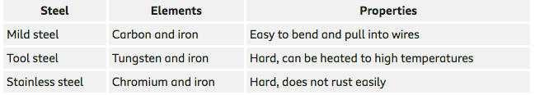
Steels are examples of alloys
There are many types of steel

Slide 12
Type of Alloy | Main Metals | Other metals | Uses | Properties
Brass
Bronze
Pewter

Slide 13
Type of Alloy | Main Metals | Other metals | Uses | Properties
Brass | Copper, Zinc | Tin | Locks, gears, bearings, doorknobs, plumbing and electrical brass musical instruments | Ductile, wear-resistance, hard, electrical conductivity, corrosion resistance.
Bronze | Copper, Tin | Aluminium Manganese Nickel, Zinc | Sculptures, musical instruments and medals, | High electrical conductivity, low friction, corrosion resistance, strong
Pewter | Tin, copper | Lead | Figurines, plates, flatware, wall art, kettles and mugs. | Low melting point Soft, easy to shape

Slide 14
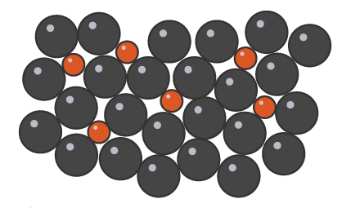
Why are alloys stronger than pure metals?
In an alloy, there are atoms of different sizes.
The smaller or bigger atoms change the neat layers of atoms in the pure metal into uneven layers
This means that a greater force is required for the layers to slide over each other.
The alloy is harder and stronger than the pure metal.
The metal lattice structure is distorted in alloys

Slide 15
Question
Explain why steel, which is an alloy of iron, is harder than pure iron?
2 minutes

Slide 16
Answer
Why is steel, which is an alloy of iron, harder than pure iron?
Steel contains atoms of other elements as well as iron. These atoms have different sizes to iron atoms, so they distort the layers of atoms in the pure iron. This means that a greater force is required for the layers to slide over each other in steel, so steel is harder than pure iron

Slide 17


Slide 18
ChemSchool worksheet
GCSE Chemistry metal alloys worksheet

Slide 19
ChemSchool worksheet answers
Describe the arrangement of the atoms in a metallic element.
The atoms are arranged in a lattice structure, close together in an orderly fashion
(i) Explain the meaning of the word malleable
able to be hammered or pressed into shape without breaking or cracking
(ii) Explain the meaning of the word ductile
able to be drawn out into a thin wire
.

Slide 20
ChemSchool worksheet answers
Explain how the structure of the alloy is different to that of the metallic element
In an alloy, there are atoms of different sizes. The smaller or bigger atoms change the neat layers of atoms in the pure metal into uneven layers
List the names of three different metal alloys and state which metals and other elements are contained in each alloy

Slide 21
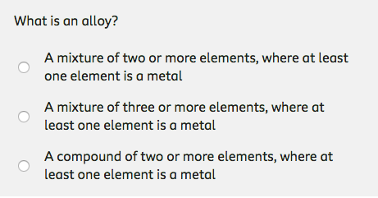

Slide 22
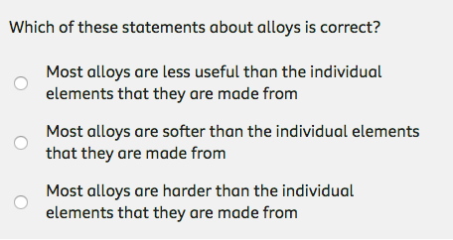

Slide 23


Slide 24
Today’s learning outcomes
Today you will be able to
identify different alloys and explain, using examples, why we use them.
explain why alloys are mixtures

